Slide 1

UCB Data Analytics Bootcamp Spring 2020 Project 1: Covid-19 clinical trials analysis
Team Pyed Pyper
Nick Nasse, Parker Prowell, Raymond Garskovas, Varun Kaushik

Slide 2
Agenda
Scope and hypothesis
Methodology
Data analysis and clean-up process
Analysis
Conclusion
Post-mortem

Slide 3
Scope and hypothesis
Our initial project outline was to uncover patterns in clinical trials related to the COVID-19 pandemic across the globe through four main analyses:
# | Analysis description | Desired result | Initial hypothesis
1 | Measuring the types of trials taking place for Covid-19 | Understand what types attributes are present for Covid-19 trials | A wide range of keywords due to the virus’ novel nature, focusing primarily on respiratory symptoms
2 | Examining relationships between overall trial growth and location | An understanding of the growth rate of trials and insight into countries conducting trials and how they compare to the rest of the world | A significant acceleration of trials being conducted in early to mid 2020 primarily in developed nations
3 | Measuring the types of organizations conducting clinical trials and collaboration | Insight into types of sponsors for trials as well as what locations are conducting trials as well as the amount of locations a given trial is using | A large number of locations per trial that are sponsored by non-profits
4 | Demographic (age / gender) comparisons across trials | A complete understanding of which demographics are most present in on-going clinical trials | High enrollment targets containing an even gender distribution but a higher presence of elderly (65+ year old) adults
Overarching hypothesis: trials related to Covid-19 are broad with a slight focus on respiratory and have grown significantly. These trials are being conducted in many geographies primarily in developed nations by independent organizations with a high degree of collaboration focusing primarily on the study of small groups made up of elderly patients of all genders
3

Slide 4


Methodology and data collection
Data source -
Due to a 1997 regulation, the National Institute of Health is required to make clinical trial data public
In the year 2000 the ClinicalTrials.gov site was launched and an API was launched in 2011
Using the API -
Made several queries from the database using “keyword” field to drive filtering of data
The keywords we selected were:
“COVID-19”
“Coronavirus”
Reduction by keywords:
2,921
Total trials in database:
346,890

Slide 5
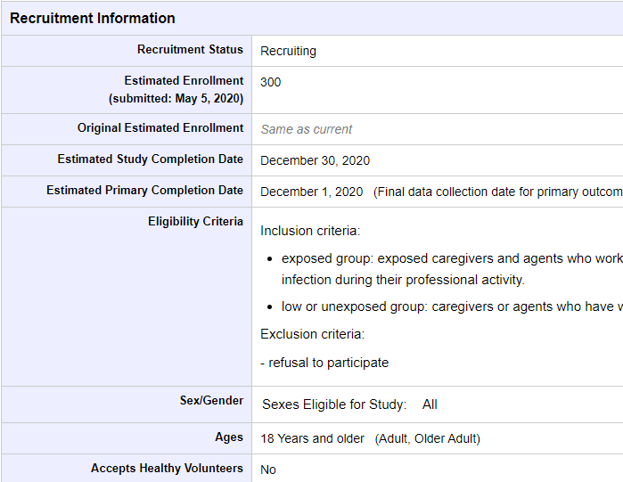
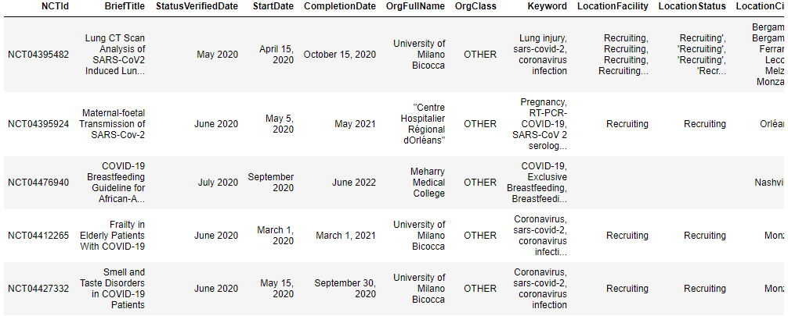
Data analysis and clean-up process
ClinicalTrials.gov source data:
A wealth of data exists in fields on the clinical trial website
Much of the data is not very standardized nor easy to interpret without background in clinical research
Definitions for fields were provided on ClinicalTrials.gov which provide guidance on which fields were relevant
Cleaning the data:
Data existed in list formats with one trial containing many keywords, cities, counties, age groups, etc.
We broke apart these lists into various data frames to understand how individual elements, such as countries, relates to clinical trials

Slide 6


Analysis 1: COVID-19 trials keyword frequency analysis
Analysis 1
Initial hypothesis: Because of COVID-19’s status as a novel virus, the frequency distribution between keywords among clinical trials related to COVID-19 would be distributed widely
Initial hypothesis: Due to its impact towards the respiratory system, respiratory related terms will have the greatest yield of keyword results
Notes:
https://nwhn.org/does-covid-19-affect-women-differently-than-men-heres-what-we-know/
https://www.npr.org/sections/goatsandsoda/2020/04/10/831883664/the-new-coronavirus-appears-to-take-a-greater-toll-on-men-than-on-women
https://www.bbc.com/future/article/20200409-why-covid-19-is-different-for-men-and-women

Slide 7
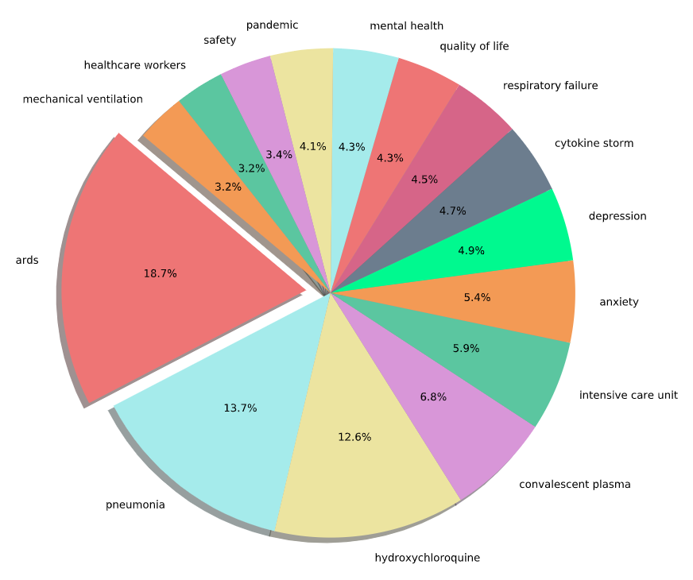
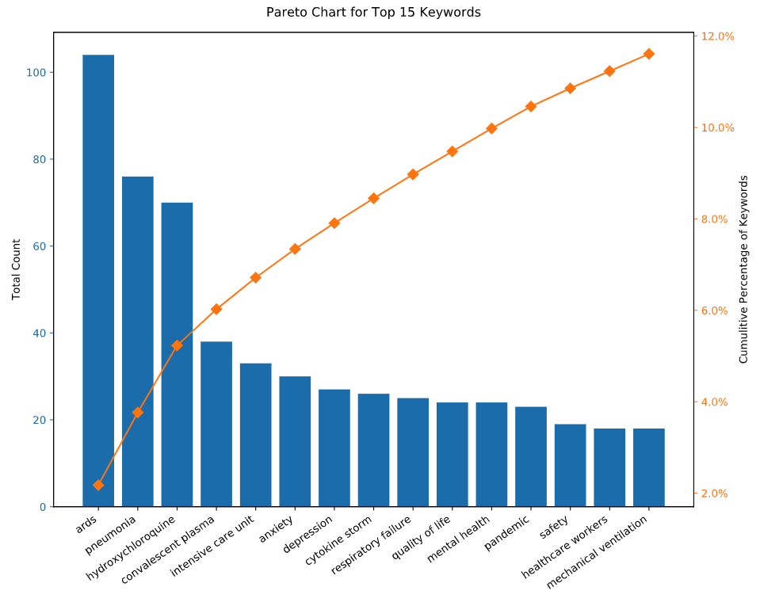
Analysis 1: Keywords Analysis
Analysis 1
Initial hypothesis: Because of COVID-19’s status as a novel virus, the frequency distribution between keywords among clinical trials related to COVID-19 would be distributed widely
We observed that no one keyword held over 20% of the total trials, implying diversification
Conclusion: The data was diversely distributed categorically across approximately 15 major categories

Slide 8
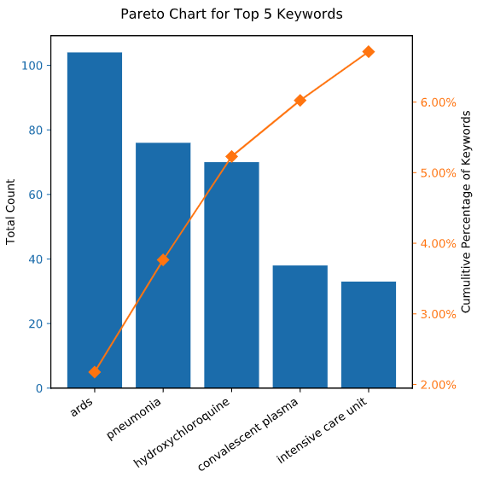
Analysis 1: Analysis of top 5 keywords
Analysis 1
Initial hypothesis: Due to its impact towards the respiratory system, terms related to the respiratory will have the greatest yield of keyword results
Based on analysis, some of the Top 5 keywords are related to respiratory while others are more general
ARDS - Acute respiratory distress syndrome
Pneumonia - Infection that inflames the air sacs in one or both lungs
Hydroxychloroquine - Immunosuppressive drug and Anti-parasite. Used to treat and prevent malaria
Convalescent Plasma - Plasma that is collected from people who have recovered from a disease, whose blood is presumed to have antibodies for that disease
Intensive Care Unit - health care facility that provides intensive treatment medicine
Conclusion: The data has proven to be greatly skewed towards trials related to ARDS and Pneumonia which are related to the respiratory system

Slide 9


Analysis 2: Analysis of overall trial growth and location of trials
Analysis 2
Volume hypothesis: the number of Covid Trials have accelerated rapidly in 2019 and into the first half of 2020
Country hypothesis: the richest countries, which maintain the most sophisticated healthcare systems, will have the highest number of trials in progress
Notes:
https://nwhn.org/does-covid-19-affect-women-differently-than-men-heres-what-we-know/
https://www.npr.org/sections/goatsandsoda/2020/04/10/831883664/the-new-coronavirus-appears-to-take-a-greater-toll-on-men-than-on-women
https://www.bbc.com/future/article/20200409-why-covid-19-is-different-for-men-and-women

Slide 10
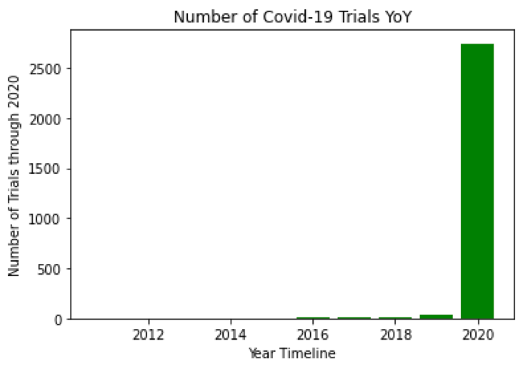
Analysis 2: Analysis of the volume of trials
Analysis 2
Initial hypothesis: the number of Covid Trials have accelerated rapidly in 2019
and into the first half of 2020
As anticipated, we observed a significant rise in the number of clinical trials taking place in 2020 with over 85% of total trials being initiated in 2020
Conclusion: despite the first trial taking place well before, the number of Covid Trials have accelerated rapidly in 2019 and into the first half of 2020

Slide 11
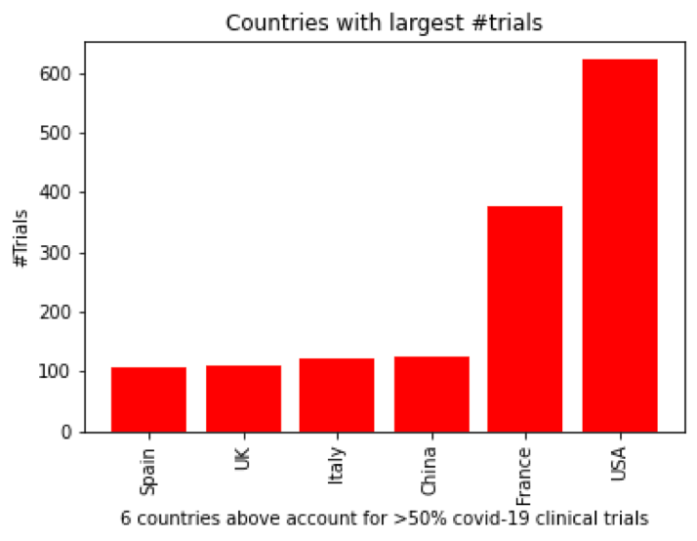
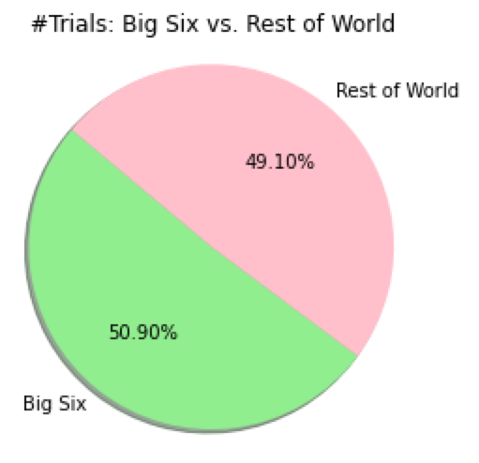
Analysis 2: Trials by Country
Analysis 2
Initial hypothesis: the richest countries, which maintain the most sophisticated healthcare systems, will have the highest number of trials in progress
We observed a total 186 unique countries running trials with a majority (>50%) of trials taking place within six countries which we labeled as the “Big Six”.
Conclusion: the number of trials may indeed depend on country wealth, but to better validate hypothesis, we would have to test against other variables such as the severity of the virus outbreak, overall population, health system quality, etc.

Slide 12


Analysis 3: Measuring the types of organizations conducting clinical trials and collaboration
Analysis 3
Sponsor type hypothesis: due to the desperation of being faced with a global pandemic, research is being conducted by many organizations, primarily not seeking profit
Location hypothesis: there are many locations per trial due to the collaboration across the healthcare world to accelerate clinical research

Slide 13
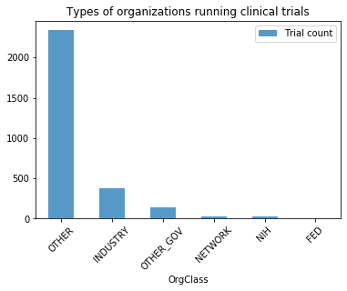
Analysis 3: The types of organizations who are running clinical trials
Analysis 3
Initial hypothesis: due to the desperation of being faced with a global pandemic, research is being conducted by many organizations, primarily not seeking profit
We observed a total the majority (~80%) of trials being conducted by “other” sponsors which according to ClinicalTrials.gov’s definition includes individuals, universities, and community-based organizations
Surprisingly, industry, meaning pharmaceutical and device companies, only account for 12% of trials and several government buckets only made up 6% of trials
Conclusion: Research is primarily being spearheaded by individuals, universities, and community-based organizations, meaning there may be a broader base of collaboration opposed to for-profit or relying on government agencies

Slide 14
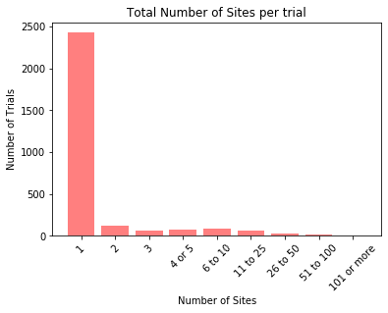
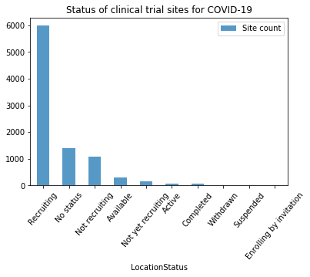
Analysis 3: The average number of locations per trial and the status of trial sites
Analysis 3
Initial hypothesis: there are many locations per trial due to the collaboration across the healthcare world to accelerate clinical research
83% of COVID trials are taking place at one location, with a long tail of several outliers
The majority (66%) of the 9,087 total locations hosting a trial are still recruiting
Conclusion: Despite the spread of coronavirus and united effort to find a vaccine across the healthcare ecosystem, trials are mostly taking place at an individual site. These sites are still primarily in the “recruitment” phase, not yet reaching full enrollment

Slide 15
Analysis 4: Analysis of Studies’ Target Demographics (Age, Gender) & Overall Enrollment Count
Analysis 4
Age hypothesis: The target age of the studies will skew towards the elderly individuals because they are the age group most impacted by COVID-19.
Gender hypothesis: The target gender of the studies will be for both men and women because both genders are at high risk of contracting COVID-19; however, it could slightly skew towards studies targeting men because they’re at a higher risk of dying due to COVID-19*.
Enrollment hypothesis: The majority of studies will have an enrollment count of less than 1000 participants due COVID-19 being a new, novel virus and the fast acting nature of the virus making it hard for patients to participate in lengthy trials.
Notes:
https://nwhn.org/does-covid-19-affect-women-differently-than-men-heres-what-we-know/
https://www.npr.org/sections/goatsandsoda/2020/04/10/831883664/the-new-coronavirus-appears-to-take-a-greater-toll-on-men-than-on-women
https://www.bbc.com/future/article/20200409-why-covid-19-is-different-for-men-and-women

Slide 16
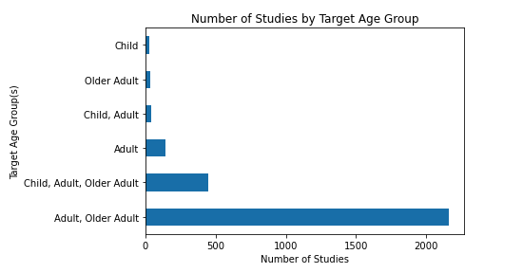
Analysis 4: Demographics
Analysis 4
Age hypothesis: The target age of the studies will skew towards the elderly individuals because they are the age group most impacted by COVID-19.
Based on our observation the vast majority of trials were focused on the “Adult, Older Adult” category
Older adults were highly represented in target age groups being included in 2,640 trials but were not the top group
Adults as were the most represented across age group categories with 2,828 studies
Age conclusion: While correct in hypothesizing that the “Older Adults” would be heavily represented, the “Adults” age group was the most represented

Slide 17
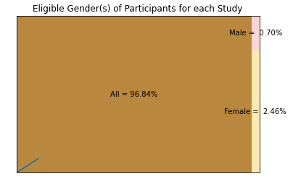
Analysis 4: Demographics
Analysis 4
Gender hypothesis: The target gender of the studies will be for both men and women because both genders are at high risk of contracting COVID-19; however, it could slightly skew towards studies targeting men because they’re at a higher risk of dying due to COVID-19*.
Based on our observation ~97% of studies focused on all genders
In studies which focused on a single sex, female exclusive studies (2.46% of total), was higher than male exclusive studies (0.70% of total)
Gender conclusion: The hypothesis that most studies would be looking for both men and women was correct; however, of those studies that looked for a single sex, female specific studies were more prevalent

Slide 18
Analysis 4: Demographics
Analysis 4
Enrollment hypothesis: The majority of studies will have an enrollment count of less than 1000 participants due COVID-19 being a new, novel virus and the fast acting nature of the virus making it hard for patients to participate in lengthy trials
We observed most studies are looking to enroll a small amount of participants with over 1,000 trials seeking between 0 to 100 participants
We observed that the vast majority (~85%) of total studies are looking for enrollment of less than 1000
Enrollment conclusion: The hypothesis that the majority of studies would have an enrollment count of less than 1000 participants was correct

Slide 19



Conclusion
Validated
Not validated
Conditionally validated
# | Initial hypothesis | Deconstructed hypothesis | Observed result
1 | A wide range of keywords due to the virus’ novel nature, focusing primarily on respiratory symptoms | Because of COVID-19’s status as a novel virus, the frequency distribution between keywords among clinical trials related to COVID-19 would be distributed widely
 |  | Due to its impact towards the respiratory system, respiratory related terms will have the greatest yield of keyword results
2 | A significant acceleration of trials being conducted in early to mid 2020 primarily in developed nations | the number of Covid Trials have accelerated rapidly in 2019 and into the first half of 2020
 |  | the richest countries, which maintain the most sophisticated healthcare systems, will have the highest number of trials in progress
3 | A large number of locations per trial that are sponsored by non-profits | due to the desperation of being faced with a global pandemic, research is being conducted by many organizations, primarily not seeking profit
 |  | there are many locations per trial due to the collaboration across the healthcare world to accelerate clinical research
4 | High enrollment targets containing an even gender distribution but a higher presence of elderly (65+ year old) adults | The target age of the studies will skew towards the elderly individuals because they are the age group most impacted by COVID-19
 |  | The target gender of the studies will be evenly distributed for both men and women; however, it could slightly skew towards studies targeting men because they’re at a higher risk of dying due to COVID-19*
 |  | The majority of studies will have an enrollment count of less than 1000 participants due COVID-19 being a new, novel virus and the fast acting nature of the virus making it hard for patients to participate in lengthy trials
Overarching hypothesis of trials related to Covid-19 are broad with a slight focus on respiratory and have grown significantly being conducted in many geographies primarily in developed nations by independent organizations with high collaboration focusing primarily on the study of large patient groups made of elderly patients of all genders is partially confirmed
19

Slide 20
Post-mortem
Difficulties that arose/ how we dealt with them:
Difficulty surrounding finding metrics for success because trials are on-going. Focused efforts on trial methodology and motivating factors rather than results, at this stage
Not being able to accurately separate columns of data. Due to the formatting of clinical trial data which is comma delimited, some names of organizations also included commas which made consistently separating those values not possible. We dealt with this by using different datapoints as a proxy to measure counts
Any additional questions we would like to explore:
How will the impact of Covid-19 impact future trials? As people become more conscious of infectious disease, will there be a shift in demographics, enrollment numbers, trial sponsors, or locations?
Perform more validation around the correlation of trial volume and severity of virus outbreak
Understanding how trials in general faired in the time of Covid-19. Presumably, the growth of Covid-19 trials and strain to the healthcare system have reduced the volume of other trials
Tracking the long term success of Covid-19 trials as well as if there are attributes consistent with successful vs unsuccessful trials

Slide 21
Questions?

Slide 22
EXTRA SLIDES

